Slide 1
Design and Integration of Portable Optical Spectrometer
CA1 Presentation by- Aung Myin Kyaw
Notes:
Hi, Good evening! I will start with my CA presentation on Design and Integration of Portable Optical Spectrometer

Slide 2
Table of contents
Project statement
Progress made
Further development
Demonstration
Notes:
This is what I will talking about. First start off with Project statement. Follow by the progress that I have made so far. And what to expect at the end of the project. And end off with the DEMO.

Slide 3
Project statement
Overall Project statement
To develop a multifunction portable Raman spectroscopes for point-of-care diagnostics.
To implement and develop a user interface of the portable optical spectrometer, which is functional, intuitive and give user more opportunity to customize according to their needs.
Notes:
Overall project statement is To develop a multifunction portable Raman spectroscopes for point-of-care diagnostics. My specific project statement is

Slide 4
Current spectrometers
Bulky and not feasible for outdoor use
Not affordable
Users have limited customization
Currently available Thorlabs, user interface has limited extensions for the future
Notes:
Currently available spectrometers are bulky and not feasible for outdoor uses. In addition they are very expensive and users have limited customization.

Slide 5
Motivation
Thorlabs program has limited functionalities and customization
Standalone program which can only be used for Thorlabs products
Creating own interface will allow us to customize and extend in the future depending on our needs
Notes:
The default program which is provided by Thorlabs is comprehensive but there are some limitations. Also it is a standalone program which can only be used for their own products. Thus, creating own user interface will allow us to customize and extend in the future depending on our needs.

Slide 6
Different components/parts of the project
Implementation of Raman spectrometer
Calculation and Optimizing results
Data analysis
User interface

Slide 7
Tasks Accomplished
Research and understanding of Raman scattering
Research on different programming languages available
Selection of Programming language
Understanding C# programming language
Coding fundamental functions to test and experiment the workability of C# in CCS100 spectrometer

Slide 8
Steps taken
Functional Specification
Behavioural Modelling
Architectural Synthesis
Logic Synthesis
Physical Design
Notes:
I will explain in the depth later on for each component. But this is the function which I have been using to create the program.

Slide 9
Functional Specification
Requirement of the program/code
Able to receive data accurately and real-time
Reliable (no lagging, lose of data)
Able to expend and additional components in the future
Code tidiness and comments
Intuitive

Slide 10

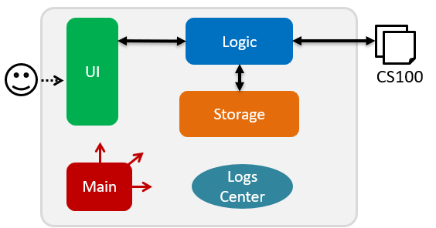
C# Programming language
Object-oriented programming language
Faster and easier to debug
The IDE available are intuitive
Widely popular language for programming window console

Slide 11
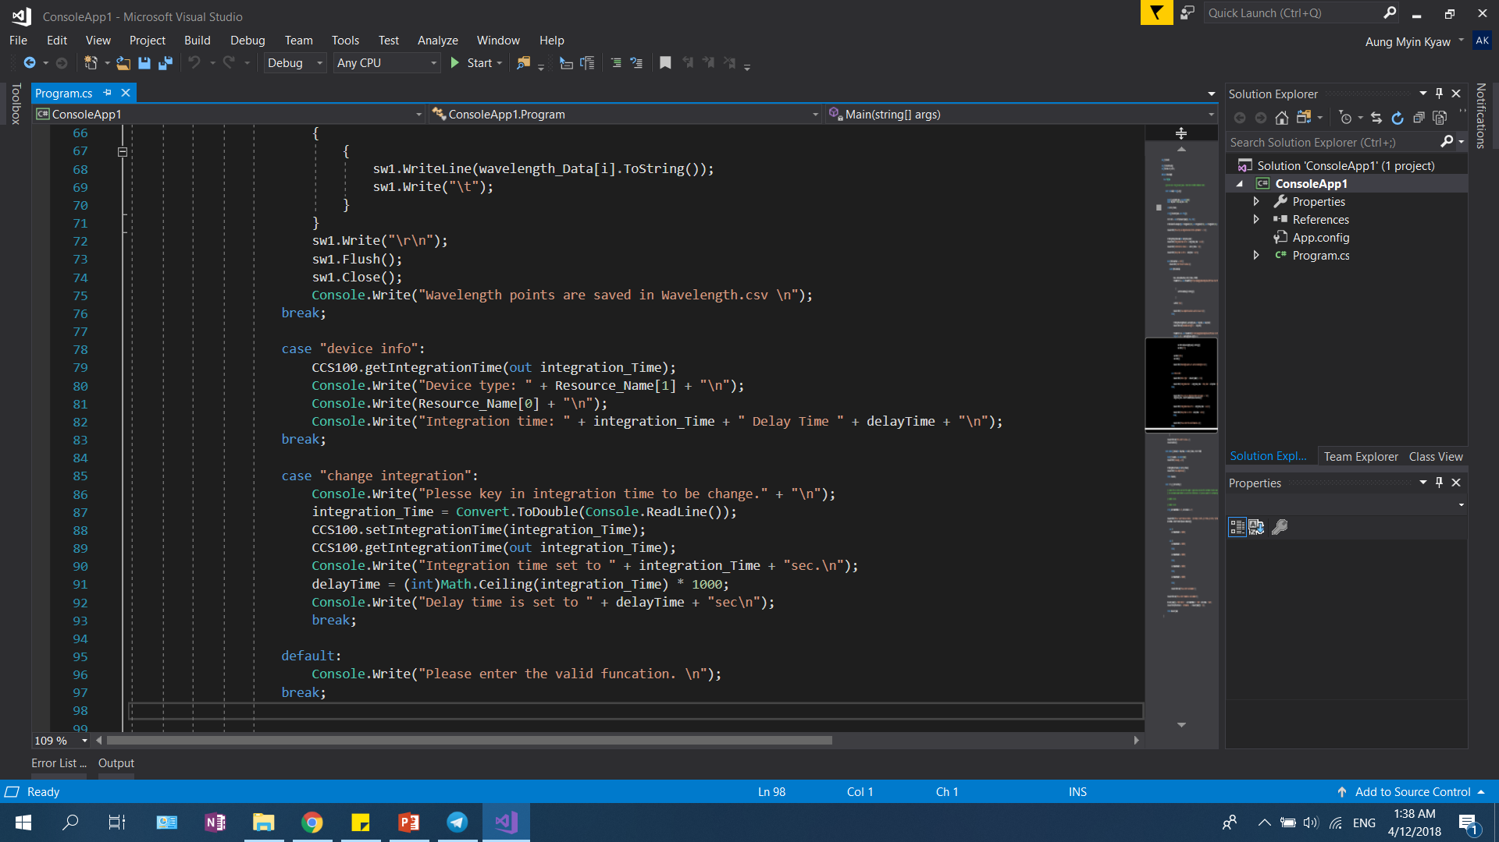
Behavioural Modelling
To ensure algorithmic correctness / functionality
Preliminary simulations
Different component of the codes are tested separately

Slide 12
Behavioural Modelling
To ensure algorithmic correctness / functionality
Preliminary simulations
Different component of the codes are tested separately
Architectural Synthesis
Combine all the components together

Slide 13
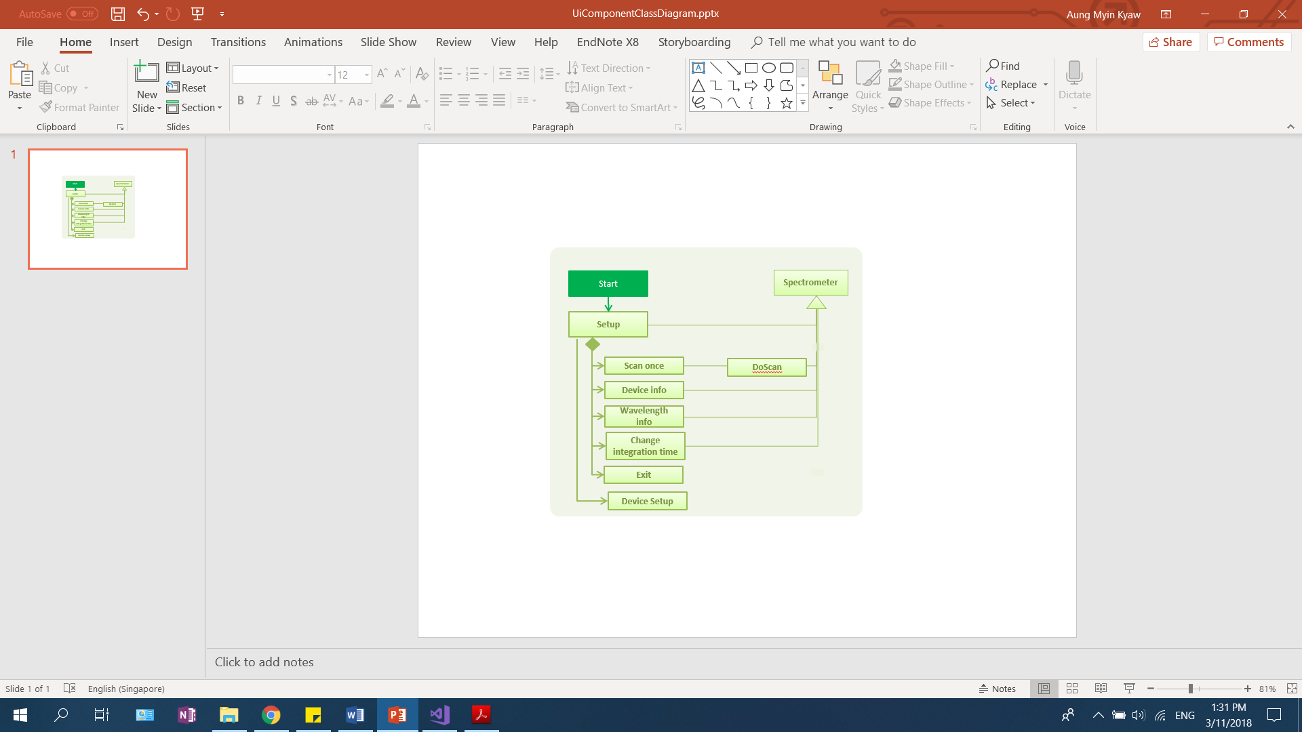
Current Algorithm Design

Slide 14
Difficulties
Understanding of the device requirement
There is no manual or explanation on how to setup and communicate with the device
Getting device model
Understanding of the importance of integration time
Garbage data collection
Unable to write to excel files

Slide 15
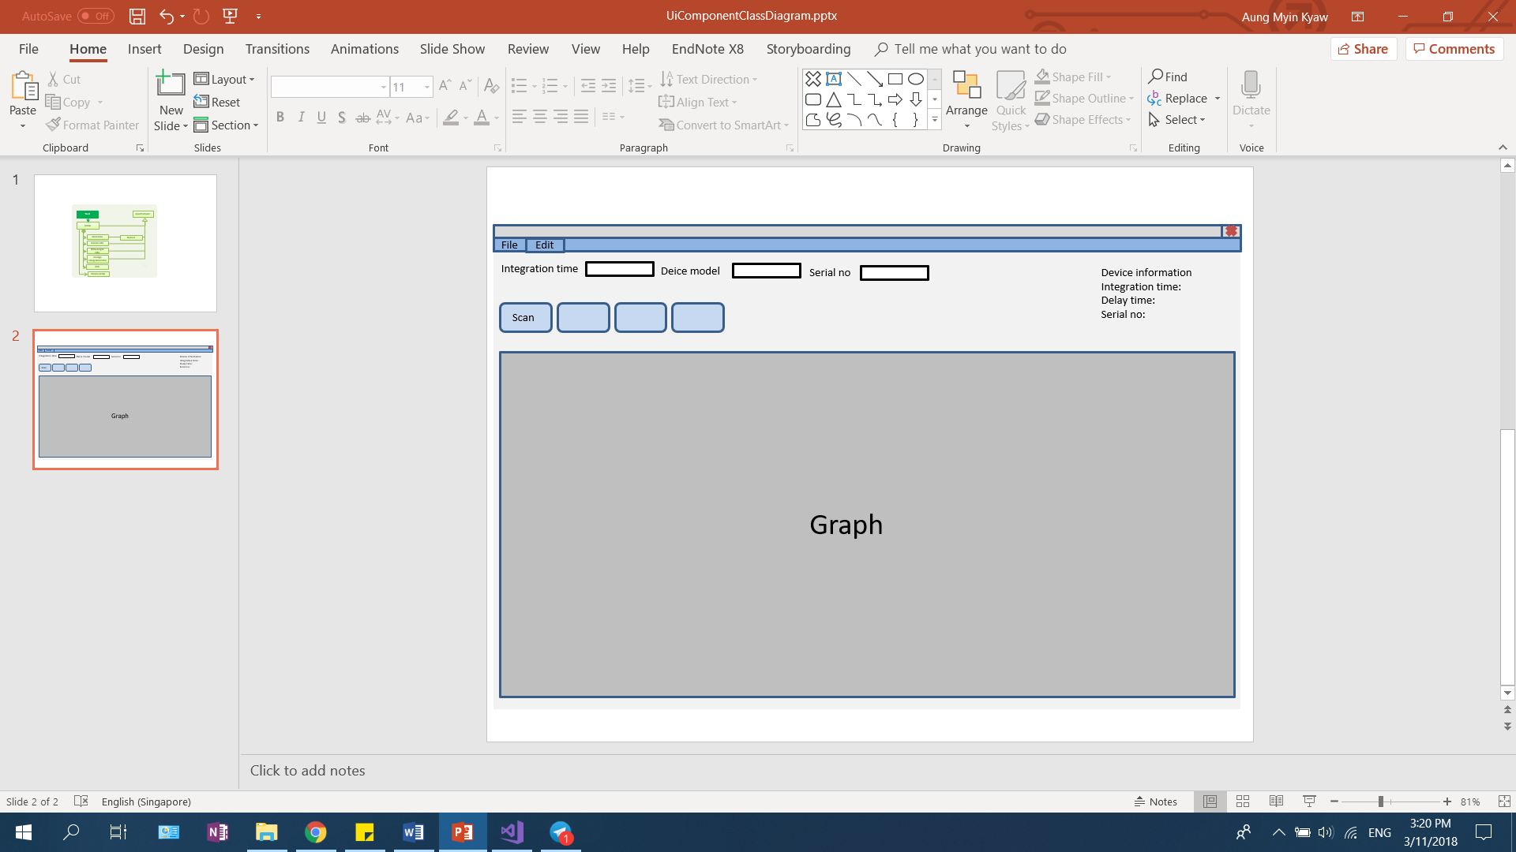
Further development

Slide 16
Further development
Implement OOP functions in the program
Using priority level to execute different tasks or an indicator to inform user when there is some background data processing
 | Dec 17 | Jan 18 | Feb 18 | March 18 | Apr 18
Designing of UI
Integration of the logical and UI
Testing and Debugging
Completion of final report

Slide 17
DEMO

Slide 18
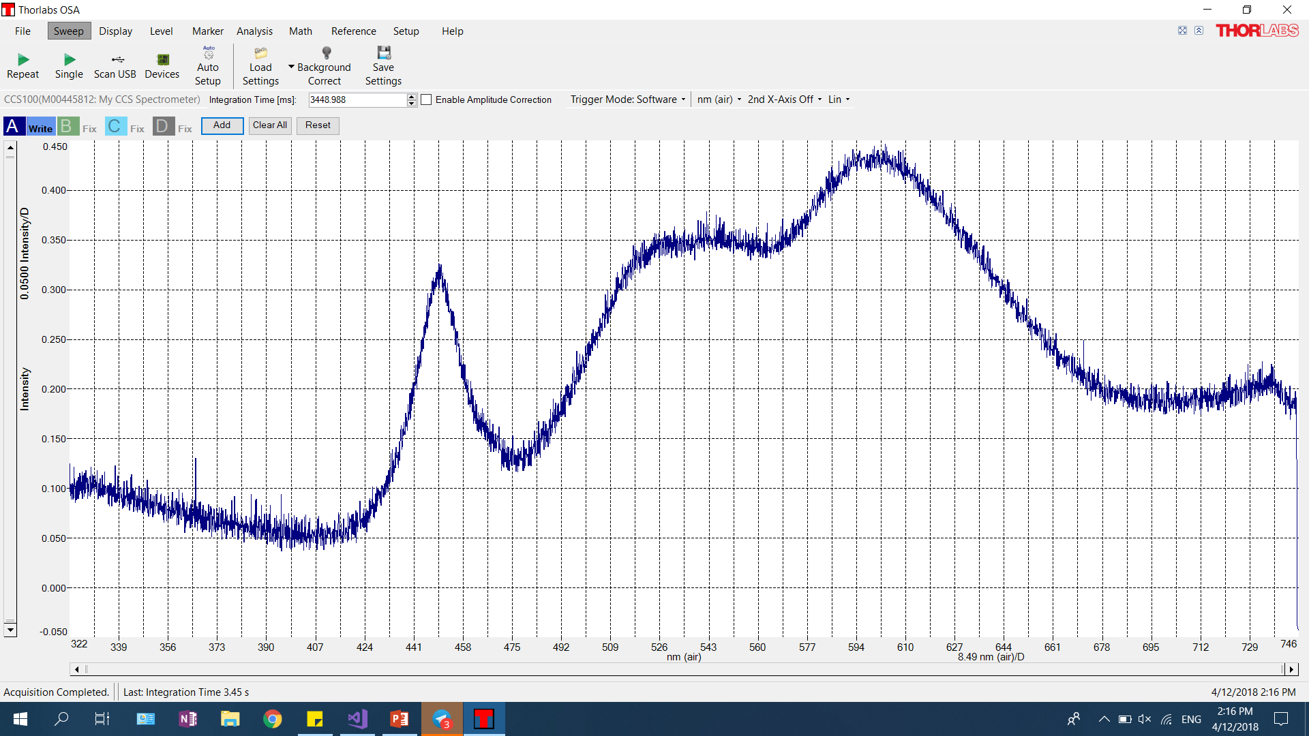

Slide 19
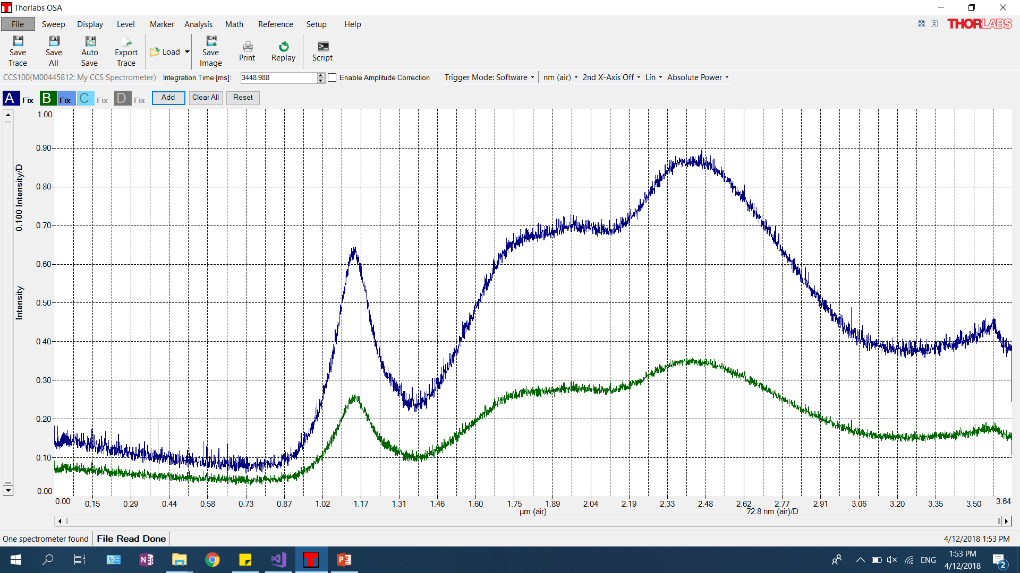

Slide 20
Q & A

